Slide 1


The California Early Care & Education Workforce Registry
Overview for Registry Users
Date

Slide 2

Overview
Presentation
Registry Live Demonstration
Workshop
Enroll in Registry
Login and explore your profile
One-on-one consultations

Slide 3






What is the California Early Care & Education Workforce Registry?
Statewide, online database designed for ECE professionals
Track & promote professional development
Secure & confidential
Free

Slide 4

Why should I join the Registry?
Accessible professional development
Instant access to a range of career tools
Easy tracking
Contribute to large-scale change
Information is used to inform policy
Advances our knowledge of gaps in training to better support providers
Data allows us to better advocate for legislation that benefits ECE

Slide 5

What tools does the Registry offer?
The Registry offers a range of tools to promote professional development:
Training Calendar
Education & Training Report
Stipends (depends on county)
Resume Builder
Job Board
Notes:
Fiona: ECE and School Age direct services providers have varying qualification requirements from baseline Community Care Licensing through various funding streams.

Slide 6

I’m an FCC Owner How does the Registry benefit me?
FCC owners can apply for Administrative Access to:
Verify employment
Store and access staff professional documentation
Education & Training Report
Generate reports
Post on Job Board
Enroll staff in trainings
Notes:
Fiona: ECE and School Age direct services providers have varying qualification requirements from baseline Community Care Licensing through various funding streams.

Slide 7
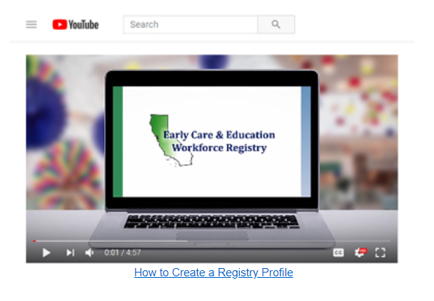

How do I to join?
You need an email address
Visit www.caregistry.org
Click on
Click the link sent in the verification email
Watch the video “How to”

Slide 8

What if I need help with the Registry?
Registry Help:
Email: caregistry@ccala.net
Phone: (888) 922-4453
Chat Monday-Friday 9:00am-5pm
Log on to www.caregistry.org
Videos
Frequently Asked Questions

Slide 9

Questions?

Slide 10

Thank you!
Contact Information:

